Slide 1


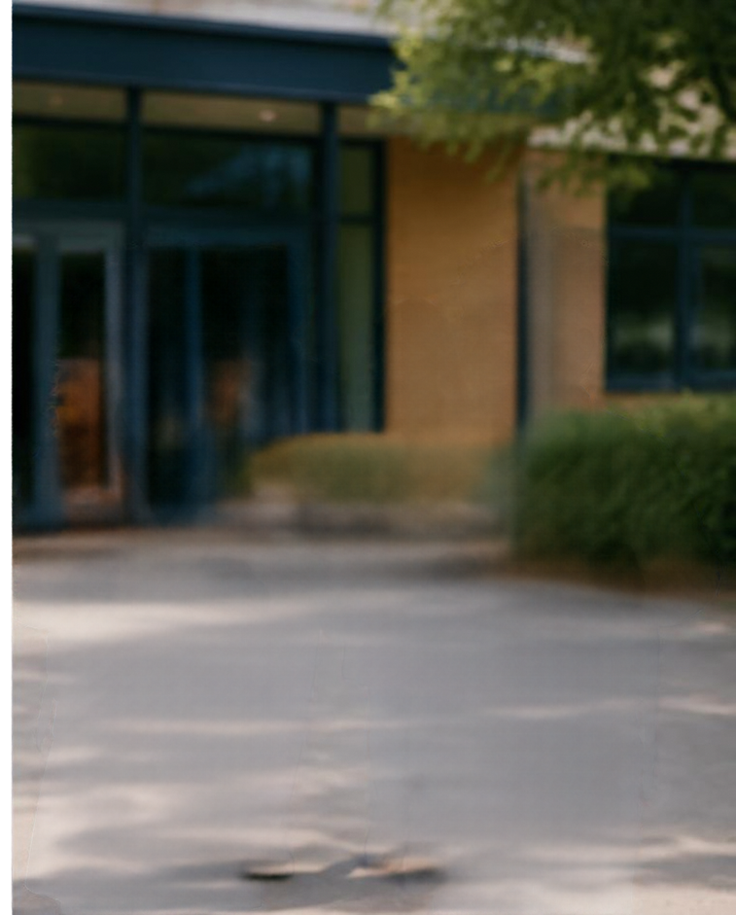




Applying for a
Secondary School
Place
2026–2027
Grove Primary School
Parent Presentation
October 2026

Slide 2








Overview of the Application Process
Four key stages from research to acceptance
01
02
03
04
RESEARCH
APPLICATION
OFFER
ACCEPTANCE
Explore secondary schools, attend open events and compare options.
Submit your online application by the deadline in October 31st 2026
Borough consider applications and make offers on 1st March 2027.
Accept the place you’re offered by 17th March 2027
SEPTEMBER 2026
OCTOBER 2026
MARCH 2027
MARCH 2027
Start researching and gathering information
Application deadline
Offer day
Respond and accept your offer

Slide 3


Important Dates and Deadlines
September 2026
Application opens
31 October 2026
Deadline for applications (local authority deadline)
1 March 2027
Offer day
17th March 2027
Deadline to accept offers
Apply on time to give your child the best chance.

Slide 4












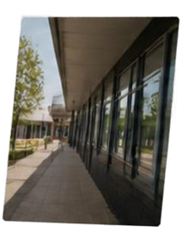























Slide 5
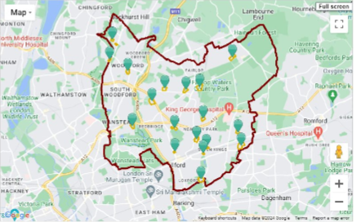
There are 19 secondary schools in Redbridge, which are a mix of community, grammar, academies and faith schools.
Check the nearest school to you by clicking on the Education tab. ​
You are strongly advised to name your catchment school as one of the higherpreferences on your application.
You will not be offered a place at some of the over-subscribed Redbridge secondary schools if you do not live within the catchment area
Remember to SUBMIT​
You can go back and make changes before 31 October but you must SUBMIT again if you do so.​
Late applications will be considered after all the on time applicants have been considered​

Slide 6


Factors to Consider
When Choosing a School
01
Location and travel options
Choose a school that is convenient and easy to reach.
02
School performance and Ofsted reports
Review results and Ofsted reports to understand performance.
03
Support for every learner
Check how the school supports pupils with additional needs.
04
Enrichment and school ethics
Consider activities on offer and whether values align.
05
Policies and local priorities
Understand sibling rules and catchment arrangements.

Slide 7



FAQs and
Support Available
Not offered your preferred school?
Another school be offered;
Can I appeal?
Yes. You have the right to appeal.
Open days and tours
Find dates and book visits on each school’s website.
Need help?
Contact the local authority admissions team for advice.

Slide 8


Next Steps and Contact Information
We’re here to help you every step of the way
Review school options and attend open events
Secondary School Application
Start the application online form
Keep track of deadlines
September 2026-2027
Grove Primary School Office
Local Authority Admissions
admin@grove.redbridge .gov.uk
www.redbridge.gov.uk/schools/school-admissions
Please reach out with any questions or if you need support. We’re here for you.

