Slide 1

Welcome to Year 1 at Grove Primary School
Outline for this Power Point:
Topic for Autumn: Childhood (History)
Topic for Spring: Bright Lights and Big City (Geography)
Topic for Summer: School Days (History)
Trips for the year
Year group expectations- homework, reading and spellings.
Phonics
Reminders

Slide 2
Topic for the term- Autumn
P.E
-Gymnastics
Main Project:
Childhood
(History)
Learn about the stages in our everyday lives.
Compare the families today to the 1950s using artefacts.
R.E
-Creation stories and festivals.
Computing
-Coding
English
-Create simple sentences
Use past tense
- Chronological order.
- Letter Formations
-Time adverbials.
Art and Design- Mix it
-Understanding primary and secondary colours.
-Learning different techniques to colour mix.
Maths
-Place Value
-Addition and Subtraction
-Shape
Science –Everyday Materials
-Naming different types of everyday materials.
-Understanding the properties of everyday materials.
Science –Human Senses
-Name body parts
-Recognise common structures between humans and animals.
-Learn the body parts related to our senses.
Design and Technology
Shade and Shelter
-Locate different shelters on the school grounds.
-Discuss the materials of the shelters and why they are fit for purpose.
-Design and create our own model shelters.
Geography-Our Wonderful World
-What is Geography?
-Understanding maps and how we can use them to locate different places.
-Use directional language and compass points to navigate around the map.

Slide 3
Topic for the term- Spring
English
--Recounts
-Capital letters and full stops. And to join two words
-Conjunctions
Main Project:
Bright Lights, Big City
(Geography)
-Physical and human characteristics of the UK.
-Learning about London landmarks and their features.
-Weather in London
-Comparing capital cities
-Learning about the Great Fire of London.
Art and Design- Rain and Sunrays
-Collagraphy printing
-Develop a motif to make a single and repeated print – linked to the weather.
-Use the technique of lines and shapes.
Science –Seasonal Changes
-The four seasons- Autumn / Winter/ Spring/ Summer.
-Weather changes in the four seasons.
-Measure the weather.
-Learn about day and night.
-Recognise that seasons have varied day lengths in the UK.
Design and Technology
Taxi!
Learn about wheels , axles and chassis.
-Understand how they are used in vehicles to make the vehicle move.
-Make their own moving taxi- design, create and evaluate.
R.E
-What do Christians believe?
How do they celebrate the birth of a baby?
Computing
-Mouse and Keyboard Skills
-Paint using computers.
Maths
-Addition and Subtraction
-Weight and volume
-Length and Height
-Place value to 50
P.E
-Dance

Slide 4
Topic for the term- Summer
English
-Question mark
Question sentences
Writing in the 1st person.
Main Project:
School Days
(History)
-Learn about their own school and locality.
Learn about the locality in the past and now.
Compare the schooling in the Victorian era to their experiences today.
Art and Design- Street VIew
-Learning about artwork on streets and buildings.
-Focus on the American pop artist: James Rizzi.
-Create a 3D mural based on Rizzi’s work.
Science –Plant Parts
-Wild and garden plants
-Exploring the local environment
-Describe the basic parts of a plant.
-Observe the changes over time.
Science –Animal Parts
-Animals including fish, amphibians, reptiles, birds, mammals and invertebrates.
Design and Technology
Chop , Slice and Mash.
Sources of food
Prepare foods by peeling, tearing, slicing, chopping mashing and grating.
Design and make a supermarket sandwich according to the design brief.
R.E
-In what ways are a church and a mosque important to Christians and muslims?
Computing
-Mouse and Keyboard Skills
-Label and group items.
Maths
-Multiplication and Division
-Fractions, Time , Money
-Position and direction.
P.E
-Dance and Gymnastics

Slide 5
Trips for the year
Autumn Term
Redbridge Museum Toys Workshop
Local Walk (geography fieldwork)
Spring Term
St Paul’s Cathedral
Summer Term
The Ragged School Museum.
(Victorian School)
We would love to have your support as parent volunteers on our school trips! Before each upcoming trip, class teachers will display a sign-up sheet on the classroom windows for one full week. To ensure a fair process, all submitted names will be drawn from a hat, and teachers will select the required number of parent helpers. Please kindly wait until the class teacher has personally confirmed your selection before making any time-off work requests or travel arrangements. Thank you so much for your understanding, enthusiasm, and continued partnership in helping our school trips run smoothly and safely.

Slide 6

Year 1 Expectations
Homework | Reading | Spelling
In year 1, the children are expected to complete a piece of homework each week. They will range from English, Maths or Topic. This will always be a consolidation of learning from across the week. They will be given a yellow homework book to complete their homework in. Homework will be given on Friday. Deadline: Wednesday PM. | In year 1, the children are expected to read at least five times a week at home. The children will change their books on a Monday. They will receive 1 phonics book, 1 book from the reading area and 1 book from our school library. Their books must remain in their bags daily. A parent or guardian is expected to complete the reading log on every occasion. Lost books: £5 charge for phonics books. £2 charge for library and class reading books. | In year 1, the children are given spellings on a Friday. They are expected to practise their spellings at home throughout the week until they have the spelling test on the following Friday. These spellings will also be practised three times a week at school as well. The spellings are the common exception words and spelling patterns for year 1.

Slide 7
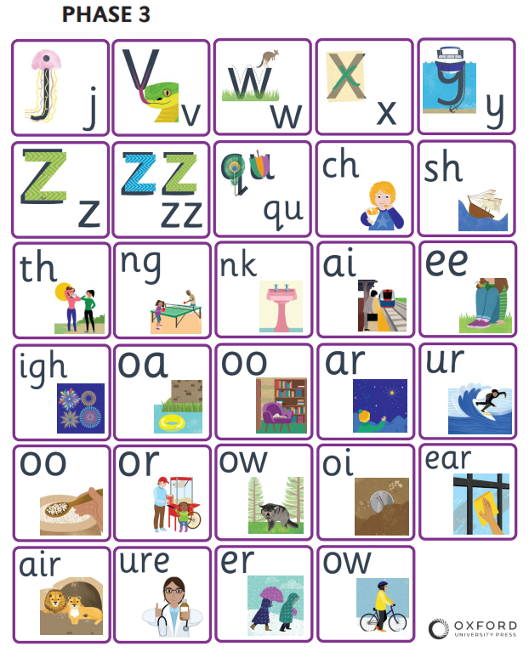
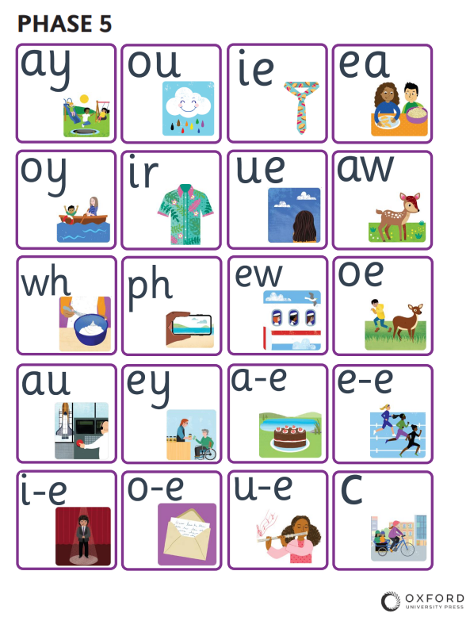
Phonics Expectations
In Year 1, we teach phonics daily, exploring a brand-new sound every single day across Phases 3 and 5 without introducing alternative spellings to keep learning clear and focused. To support this, your child will receive a weekly phonics reading book matched specifically to the exact sounds they are learning in class, rather than their general reading level. This ensures they can practice and apply their new decoding skills with confidence at home. To help you support your child, please watch the video linked on our website, so you can practice pronouncing these sounds together correctly at home.

Slide 8
Parent Support
Labelling possessions
Please ensure children’s P.E. kits are clearly labelled including each plimsoll.
We would also ask that you label coats, jumpers and jackets with a permanent marker along with your child’s class.
Water Bottles
The school has a policy that children bring water bottles to school and are encouraged to drink water throughout the day. Please ensure your child has a water bottle and praise them for drinking during the school day.
Absences
It is really important that your child is in school on a regular basis so that they can achieve the most out of their education and this will in turn give them an opportunity to win an attendance prize.
PE
Please ensure your child has the correct PE kit for indoor and outdoor PE and that they wear their PE kit to school on PE days. These days can change throughout the year- look out for school notices. Please make sure that your child has no earrings in on PE days.

