Slide 1


Slide 2
The Year 3 Team
3N Class Teacher: Miss Nadeem
3W Class Teacher: Mrs Wahab
3R Class Teacher: Miss Alexander and Mrs Ramskill

Slide 3
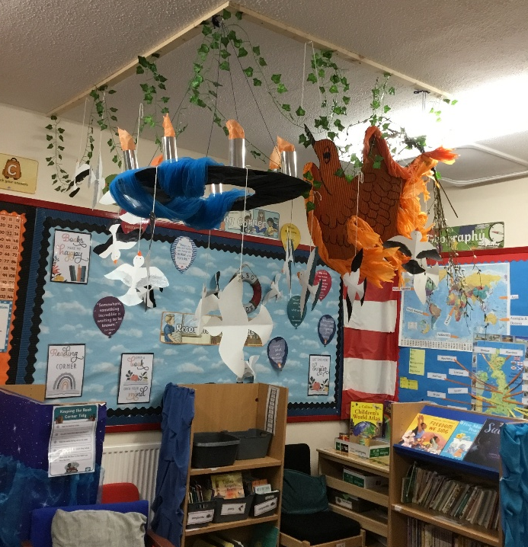
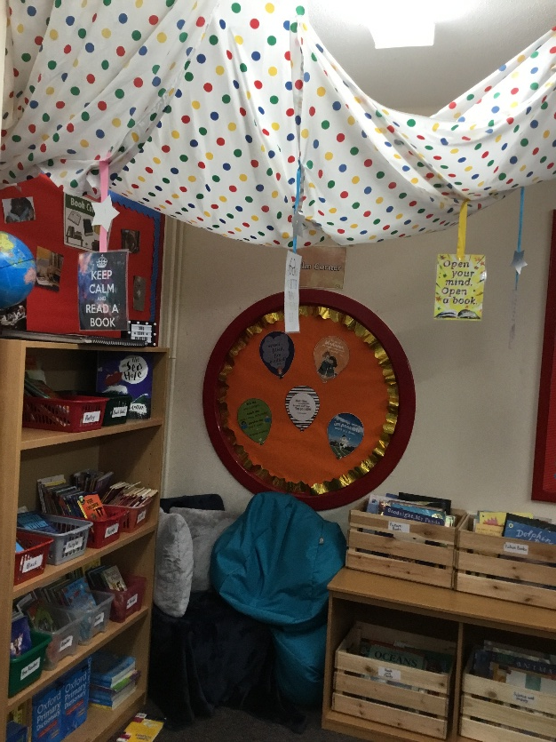
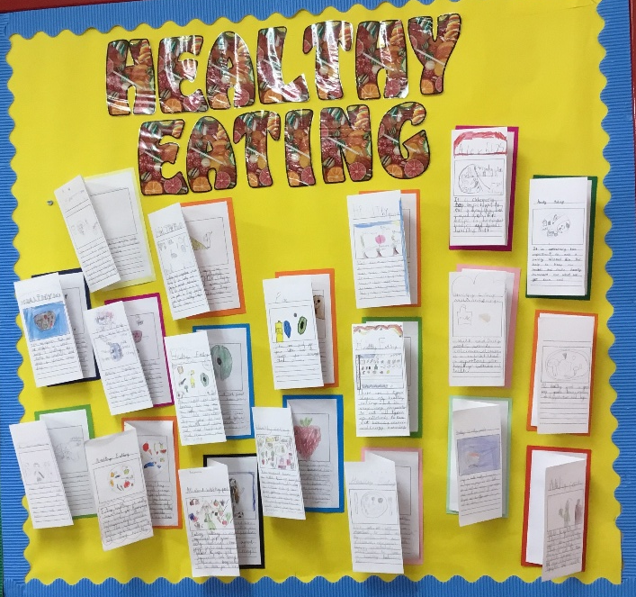
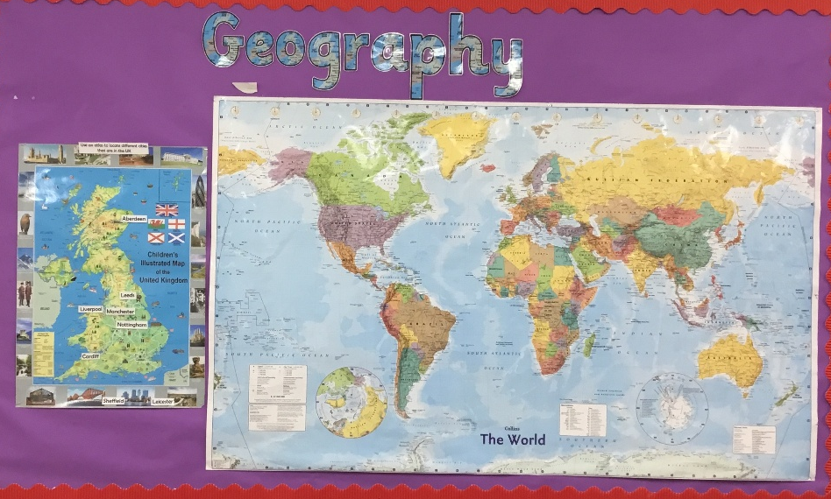
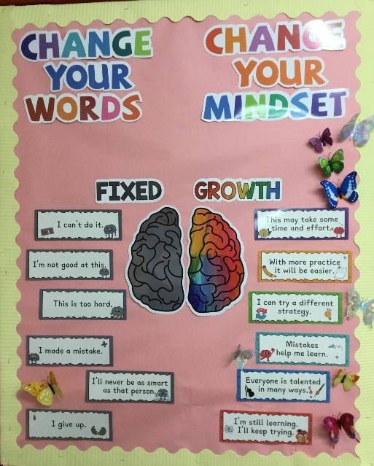
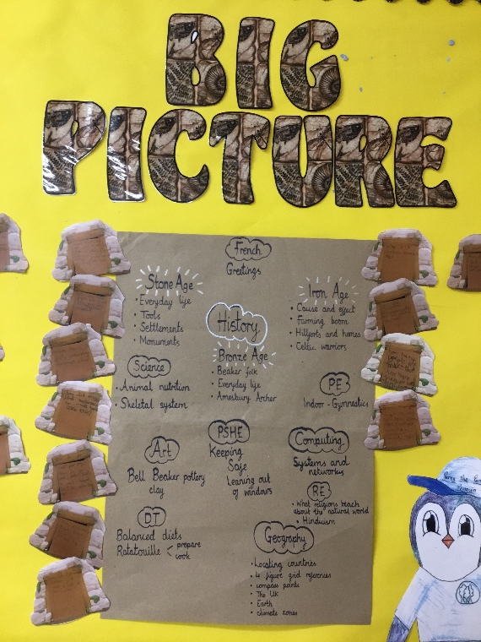
Our Classrooms

Slide 4
Autumn topics
History - Stone Age, Bronze Age and the Iron Age
Art - Prehistoric pots
English
Description
Diaries
Instructions
Haikus
Science - Animal nutrition and the skeletal system
DT – Cook well, eat well
Maths
Number, place value, addition, subtraction, multiplication and division
Geography - One Planet, Our World

Slide 5
Spring topics
English
Description
Narratives
Diary
Persuasion
Non chronological reports
Geography -Rocks, relics and rumbles
Art – Ammonite
DT -Making it move
Science - Forces and Magnets
Maths
Length and perimeter
Fractions
Mass
Capacity

Slide 6
Summer topics
Art
Mosaics
History - The Ancient Romans
English
Retell
Newspaper
Suspense
Explanation
Poems
Science - Plant nutrition and reproduction
Light and shadows
DT Greenhouses
Maths
Fractions
Money
Time
Statistics
Shape

Slide 7
Our trips, theme days and assemblies
Keith Axon library once a term
RE assembly – Monday 9th November
Topic assembly - Monday 10th May (to parents)
Theme day – ‘Prehistoric times’ and Roman Day
Hindu Mandir

Slide 8

Homework Expectations
Arbor: Children will be given homework on Arbor weekly. Each week, this will be a different area of learning. Children should complete the homework in their homework books, or on the sheet if you wish to print it.
Homework will be set on a Friday and should be submitted by Wednesday.
Please ensure that an adult is overseeing and supporting the homework process.
Spellings: These will be uploaded on Arbor every week.
Remember to practise daily ready for the spelling test on Fridays.

Slide 9


Reading:
Your child must read at home at least 5 times a week.
Reading records must be in school every day.
Children are encouraged to start writing their own comments about what they have read, and parents check and sign each read.

Slide 10
Number bonds
We are working extremely hard to ensure that children become proficient at recalling number facts and bonds.
Alongside this, we are also practicing our times tables.
Please encourage children by using the following websites.
https://ttrockstars.com/
https://www.topmarks.co.uk/maths-games/daily10
https://www.topmarks.co.uk/maths-games/hit-the-button

Slide 11
Parent Support
If you need to speak to your child's class teacher, please arrange a time to meet or have a phone call.
You can call the school office on: 020 8590 3611
Or send an email to: admin@grove.redbridge.sch.uk

