Slide 1
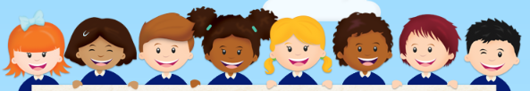
Welcome to Year 4
Meet the Team:
Class teachers
4R – Miss Rajan
4B- Mrs Berbank
4RB – Mrs Begum
Year group LSAs
Mrs Kuzyk
Mrs Vijh
Mrs Kilic

Slide 2
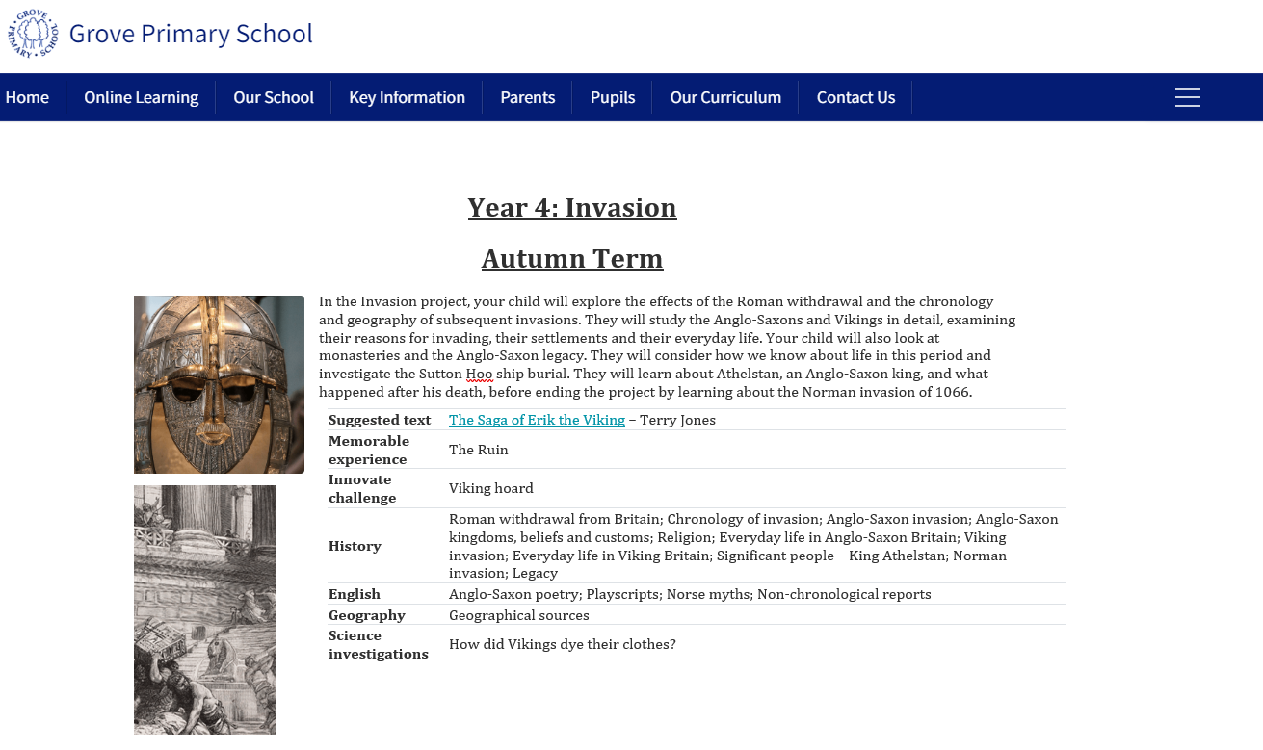

Our topic this term is:
The Year 4 Curriculum Guide for the whole year can be found on the School Website.
Invasion

Slide 3
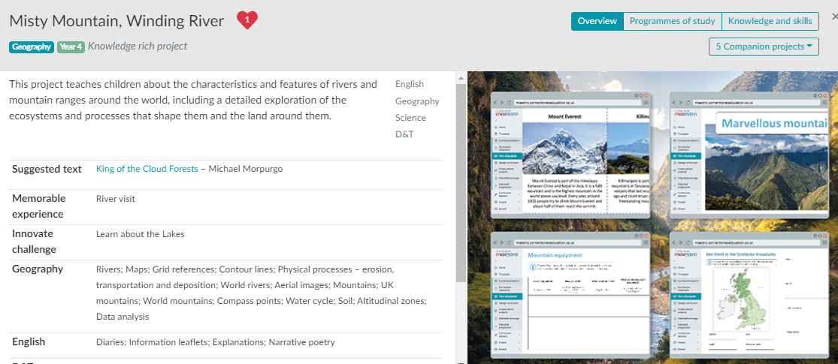
Spring Term

Slide 4
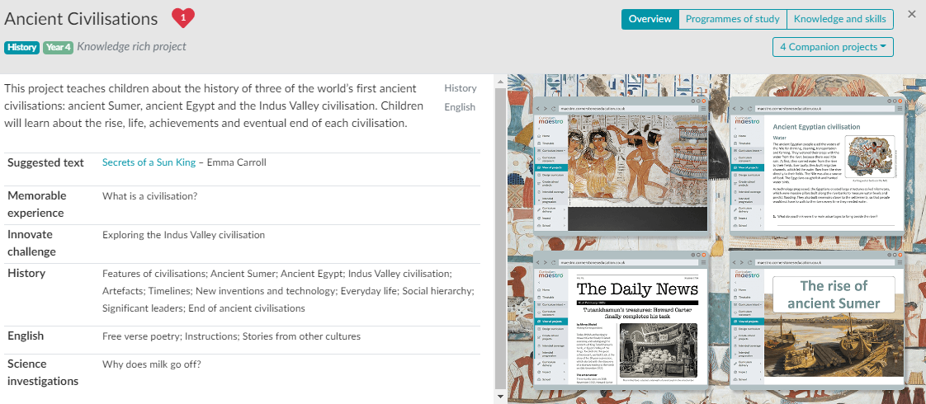
Summer Term

Slide 5
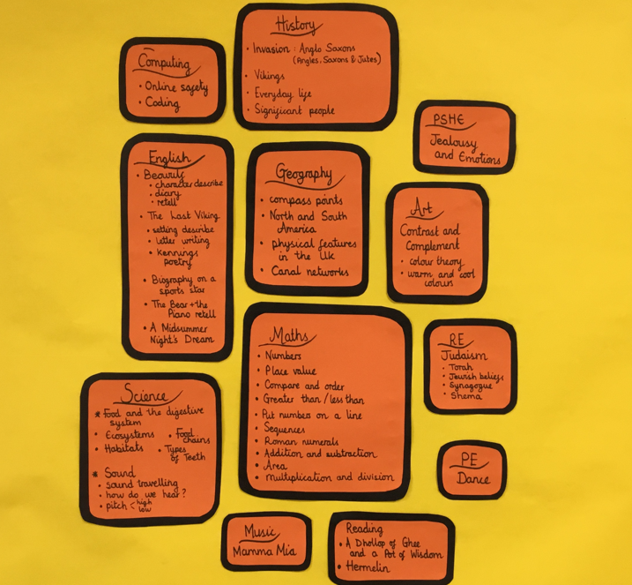
The Big Picture
In every classroom there will be a big picture display informing the children what they will be learning each term.

Slide 6
Homework Expectations
Maths or English:
We will alternate the homework each week and this can then be submitted on Arbor as a picture.
*Available on a Friday and should be submitted by Wednesday.
Please ensure that an adult is overseeing and supporting the homework process.
Spellings: These will be uploaded on Arbor every Friday.
*Remember to practise daily ready for the spelling test on Friday.

Slide 7
Year 4 Reading at home
Reading fluently and reading for pleasure are the biggest indicators of success.
Reading should be a priority for your child when at home.
Reading 5 times a week
Your child must be reading and recording a detailed comment in their records at least five times a week at length. 'Good reading' is not sufficient.
Parents please sign or initial each of these reads and how many pages they have read.

Slide 8

Year 4 Times tables
Practice Everyday
It is very important that children practise their times tables daily as there is a national test for Year 4 children, which they will complete later in the year.
They are expected to know all their tables up to 12x12. They will be assessed weekly.
We encourage your children to access Times Tables Rock Stars, Maths shed, Hit the Button or Daily Ten to practise them. All children will have their individual login. Children must complete this independently.

