Slide 1

Welcome to Curriculum Evening
Grove Primary School
Year 5

Slide 2
Y5 Class Teachers
5C
Miss Clinton
5EC
Mrs Cerkezi
5P
Miss Patel

Slide 3
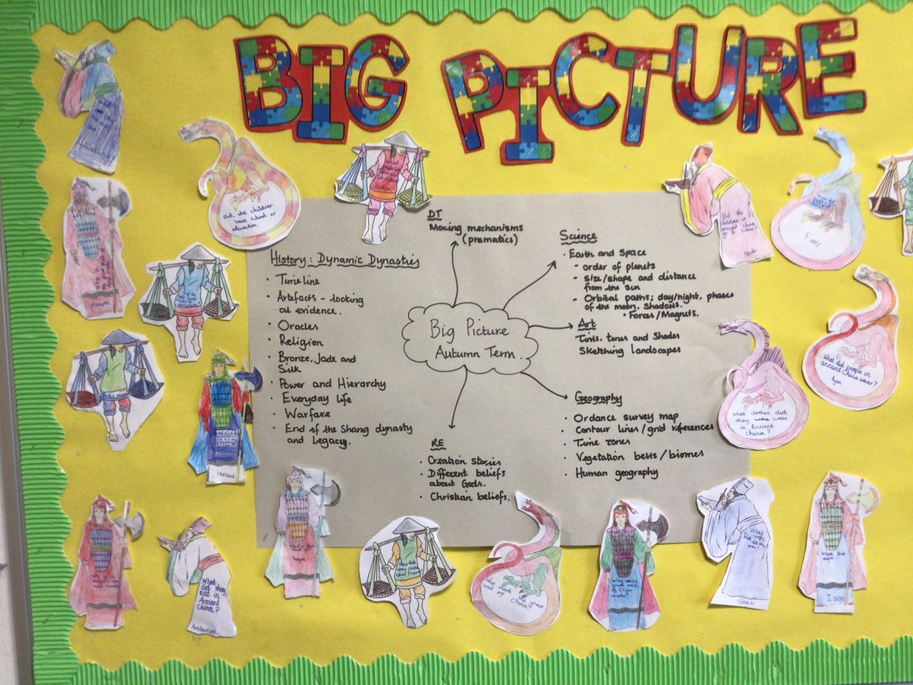

Curriculum: The Big Picture

Slide 4
Curriculum overview
Spring Term
English - Poetry, Skellig, Charlotte's Web, Blackberry Blue and other tales
Maths – Multiplication, division, fractions, decimals and percentages
Science – Property and changes of materials
Art and Design – using different types of media
Computing - databases
Geography – Sow, grow and farm
Music – Charanga – Fresh Prince of Bel Air
DT – Eat the seasons
PE – Dance/Gym
PSHEE – First Aid/looking out for others
French – Places and Food
RE - Christianity
Summer Term
English - Antigone , Kensuke's Kingdom, Explanation Texts, Cloudbusting
Maths – Shape, geometry, position and direction, converting units and volume
Science – Lifecycles and humans
Art and Design - Mixed media
Computing - video editing
History – Groundbreaking Greeks
Music – Charanga – Dancing in the Street
DT - Architecture
PE – Dance/Gym, Athletics/Swimming
PSHEE – HRSE/Legal and illegal drugs/
French - Beaches
RE – Sources of Wisdom/ Charities

Slide 5
Reading
Reading to a member of staff: The number of times each child will be listened to, is dependent on their ability. This will be recorded in their reading records.
Reading at home: Part of our homework policy is that children should read at length, a minimum of 5 times a week at home. We also ask that the children make a comment in their reading record and ask a parent to sign this. We monitor the reading records on a weekly basis.

Slide 6
PE
PE lessons take place twice a week; one indoor and one outdoor.
For indoor lessons, the children will need to wear their PE kit under their uniform so that they can remove this and be ready for PE.
For outdoor PE lessons, the children will need to come into school wearing their PE kit. They will remain in their kits all day.
If your child attends an after-school sports club, they will require a change of clothes. The children should bring this in on the day, in a bag.

Slide 7
Homework
Homework is given out once a week, on a Friday, and can be submitted on Arbor. Homework will be made up of one written task, reading, spellings and times tables.
The use of Timetable Rockstars supports the children’s learning and we ask that you encourage them to log in and practise their times tables and number facts. The children should have their log in details, but any problems should be referred to the class teacher.

Slide 8
Communication
It is good for the children to know that there is communication between parents and teachers.
If you have any questions or concerns, please email the class teacher or call the office to make a telephone appointment.
Please ensure that you let the office know of any changes to your contact details. It is important that we have current details in case of an emergency.

