Slide 1

Grove Primary School
Year 6 Curriculum Presentation

Slide 2
Year 6 Teachers
6C: Miss Choksi
6M: Mrs Makwana
6S: Mrs Selzer

Slide 3
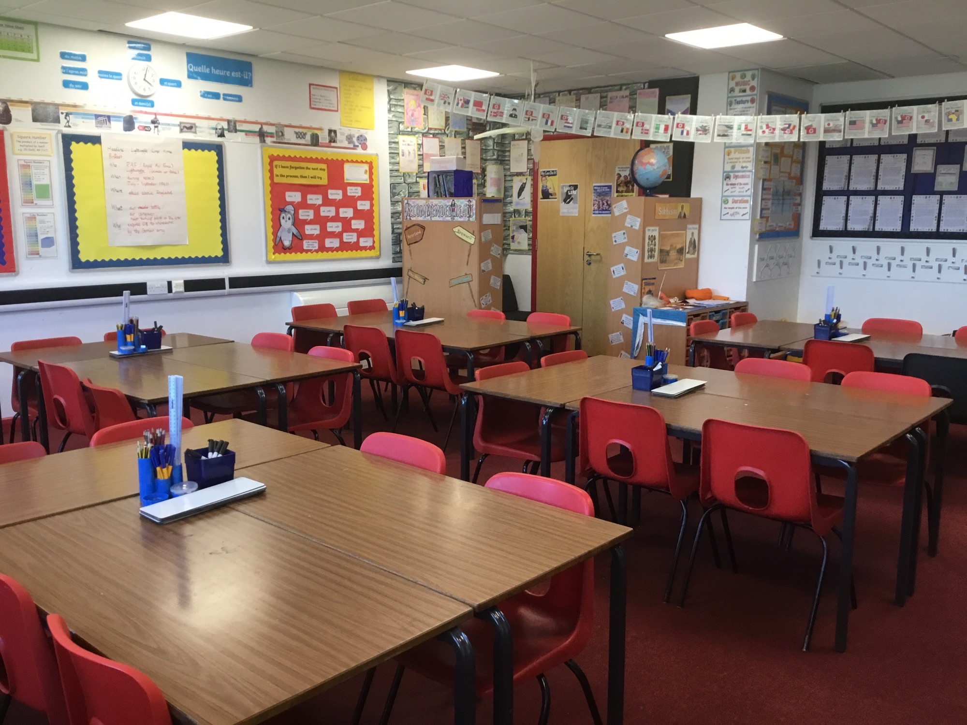
Year 6 Classroom

Slide 4
Year 6 Curriculum
This year our topics and book focuses are:
Autumn Term
Mafaa and the book ‘Freedom’ by Catherine Johnson
Circulatory system
Spring Term
Frozen Kingdoms and the book ‘The Wolf Wilder’ by Katherine Rundell
Electrical Circuits and Components
Summer Term
Britain at War and the book ‘Rose Blanche’ by Ian McEwan and Roberto Innocenti
Light Theory
Evolution and Inheritance

Slide 5
Year 6 Trips and Visitors
Autumn Term
Visit to Gurdwara
Visit to Keith Axon Library
Spring Term
Visit to Keith Axon Library
Summer Term
Residential
Visit to Keith Axon Library
Visit to Redbridge Museum
Leavers’ lunch

Slide 6
Key Dates
Year 6 topic assembly – 11th January 2027
SATs week – week beginning 10th May 2027
Residential visit – 7th-9th July 2027
Leavers’ Concert – 20th July 2027

Slide 7
Homework
Year 6 children have diaries, which they record their homework in, to support the transition to secondary school.
Maths homework is handed out/uploaded on a Wednesday and is due in the following Monday.
English homework is handed out/uploaded on a Friday and is due the following Wednesday.
Spellings are handed out/uploaded on a Friday and spelling books are checked the following Friday.
Homework will increase over the course of the year, so we encourage children to complete their homework tasks as and when they receive it rather than leaving it to the last minute. This will also give children the opportunity to ask their teacher for help should they need it.
In the spring term, children will receive Spelling, Punctuation and Grammar homework. This will be given on Monday and be due on Thursday. Some children will receive booster homework.
Children must read at home at least 5 times a week at length (a couple of chapters or 20-30 minutes) each time they read. This will be checked on Friday. Children must write a comment in their reading record to acknowledge they have done this, a signature from home is not necessary in year 6.

Slide 8
Communication
If you have any questions or concerns, please email the school office or call to make a telephone appointment.
Please ensure that you let the office know of any changes to your contact details. It is important that we have current details in case of an emergency.

